Slide 1

What’s new and what’s next
PowerUp 2025

Slide 2



About Michael Dawson
Node.js lead for Red Hat and IBM
Active Node.js community member
Node.js Collaborator, Node.js Technical Steering Committee,
Active in a number of Working group(s)
Active OpenJS Foundation member
Voting Cross Project Council Member
Community Director 2021-2022
BlueSky: @mhdawson.bsky.social
Twitter: @mhdawson1
GitHub: @mhdawson
Linkedin: https://www.linkedin.com/in/michael-dawson-6051282

Slide 3
Overview
What’s Not New
Recent survey
What’s new
Features
Trends
What’s next

Slide 4


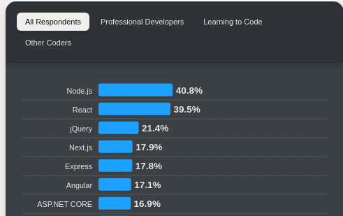
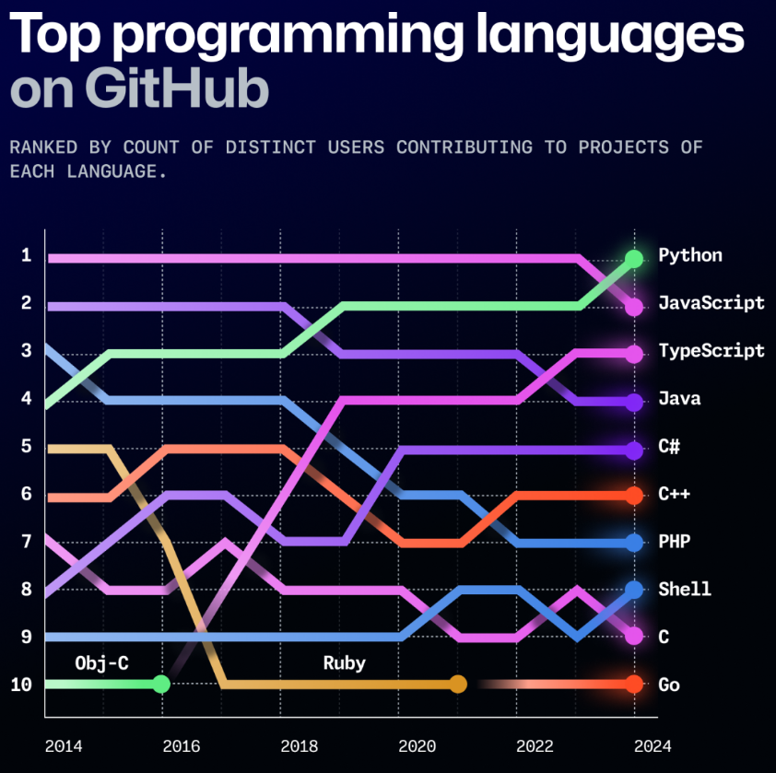
What’s not new
* Even after docker activities pushing people to cache
Massive usage in last year
Over 1B downloads from
Almost 800M docker pulls*
Tops recent surveys
.org
2 - JavaScript
3 - typeScript
Notes that combined still higher than Python
https://survey.stackoverflow.co/2024/technology/
https://github.blog/news-insights/octoverse/octoverse-2024/

Slide 5
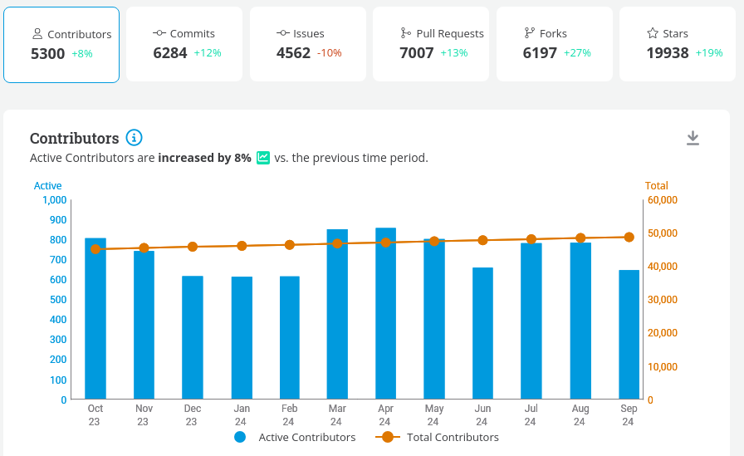
What’s not new
Active and vibrant project
https://insights.lfx.linuxfoundation.org/foundation/ojsf/overview/github?project=ojsf-nodejs (Oct 1 2023 - Sep 30 2024)

Slide 6
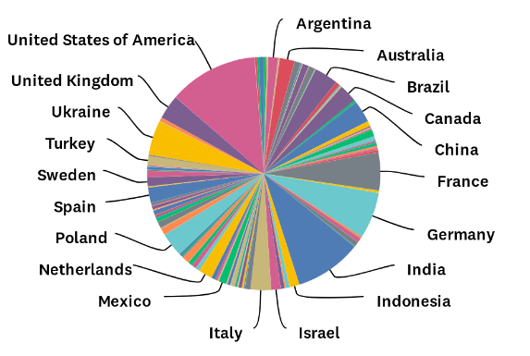
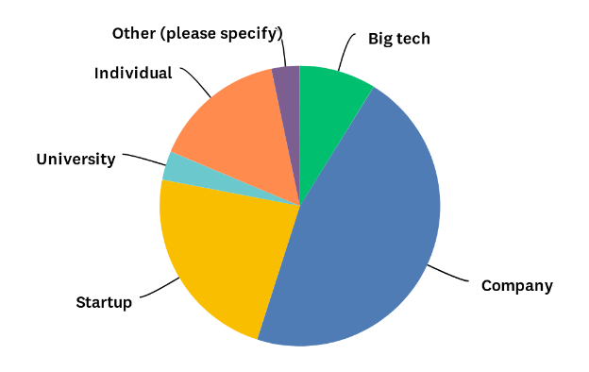
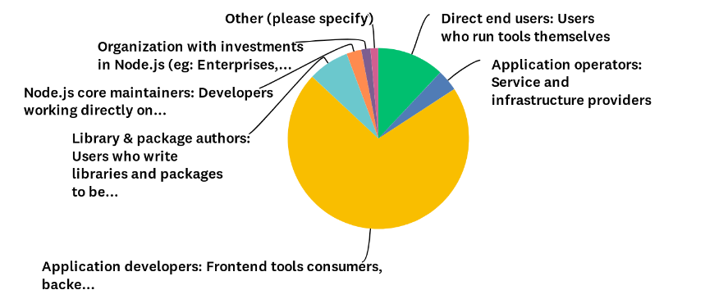
Recent Survey
2978 respondents, 81% more than last year
Average of 6 years using Node.js
https://github.com/nodejs/next-10/blob/main/surveys/2024-04

Slide 7
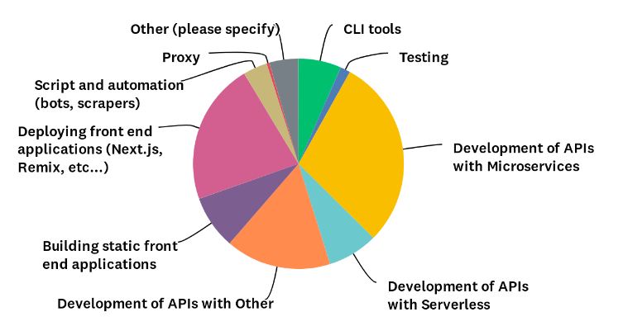
Recent Survey
53% back end services
22% deploying front end apps
21% building, and scripting
Use Cases
https://github.com/nodejs/next-10/blob/main/surveys/2024-04

Slide 8
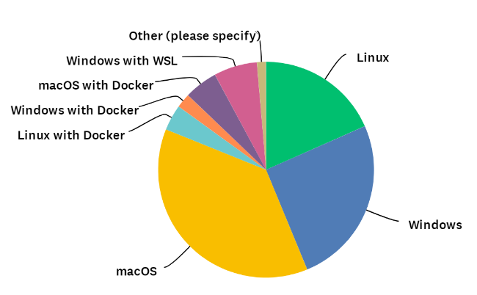
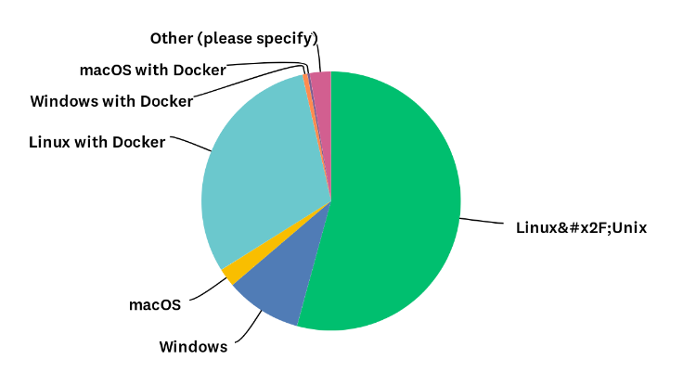
Recent Survey
18% (+11%)
26% (+9%)
38% (+5%)
Local Development
Production
x86 dominates but Arm is growing
https://github.com/nodejs/next-10/blob/main/surveys/2024-04

Slide 9
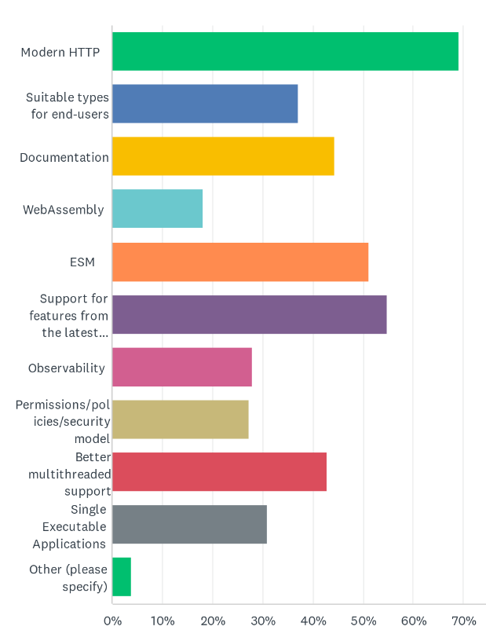
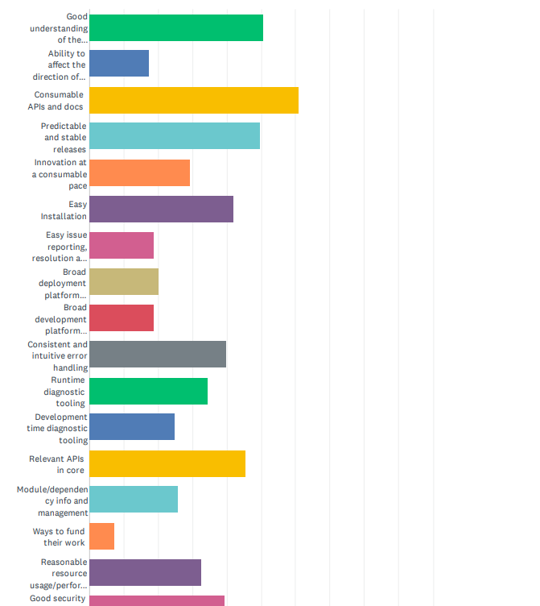
Recent Survey
Technical Priorities
What’s important to you (incomplete list shown)

Slide 10
Recent Survey
Key Takeaways
Most common pain points
ESM integration
TypeScript
Docs
Monitoring/Diagnostics
Performance
ESM widely used, 71% reported code with ES module syntax
New stable features well used
Experimental features well used
https://github.com/nodejs/next-10/blob/main/surveys/2024-04

Slide 11
What’s new - Features
Major Releases
Boring…….
SemVer Minor is where its at!
features (but not all) flow into Current/LTS lines
Majors still a good time to party
Talk about recent new features
Promotion to LTS

Slide 12
What’s new - Features
2024 was Exciting year
Some Highlights
Progress on ESM compatibility
Experimental Limited TypeScript Support
Experimental Web Storage API
Experimental SQLite API
Continued progress on performance
Node run
Regular Releases
Most common pain points
ESM integration
TypeScript
Docs
Monitoring/Diagnostics
Performance
✅
✅
✅

Slide 13
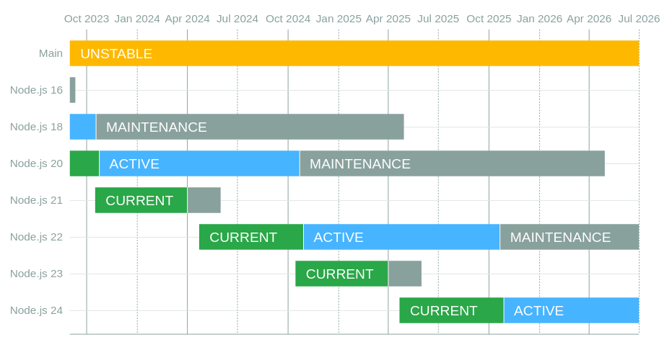
Releases
Last Major Release
24.x in April 2024 (Curent)
Ongoing LTS Releases
Node.js 18.x - ends April 2025
Node.js 20.x - ends April 2026
Node.js 22.x - ends April 2027
Next current
25.x in Oct 2024
https://github.com/nodejs/Release

Slide 14
ESM Compatibility
hello.js
const greeter = require('./greeter.js').default;
const greeting = greeter('World');
console.log(greeting);
CJS
greeter.js
import util from 'node:util';
export default function (greeting) {
return 'Hello ' + greeting;
};
ESM

Slide 15

It just works!
>node hello.js
Hello World
Backported to 22.x in 22.12.0
The Fine Print:
Depends on two features that are still experimental but stability is “release candidate”, and no experimental warnings.
Options to turn of in case of issues
--no-experimental-require-module
-> ESM must be synchronous
--no-experimental-detect-module
-> depends on syntax detection - https://nodejs.org/api/packages.html#syntax-detection
-> may load file twice
-> recommended to use "type": "module" in package.json where possible

Slide 16
Experimental Limited Typescript Support
At a glance
--experimental-strip-types (enabled by default in v23.6.0)
replaces TypeScript with whitespace
no need for source maps
.ts, .mts, .cts files supported
--experimental-transform-types (not enabled by default)
Key limitations
Only supports a subset of TypeScript
Does not handle files in node_modules (design choice)
Does not read tsconfig.json
type keyword needed in imports
https://nodejs.org/api/typescript.html - Stability: 1.1 - Active Development

Slide 17
Experimental Limited Typescript Support
hello.ts
greeter.ts
import { GreetOptions } from './greeter.ts'
import greeter from './greeter.ts'
const message: string = 'World';
const greeting: string = greeter(GreetOptions.Hello,
message);
console.log(greeting);
export enum GreetOptions {
Hello,
Goodbye
};
export default function (helloType: GreetOptions, greeting: string) : string {
let world: string;
if (helloType === GreetOptions.Hello) {
world = 'Hello ' + greeting;
return world;
};
throw Error('Unknown GreetOption');
};

Slide 18
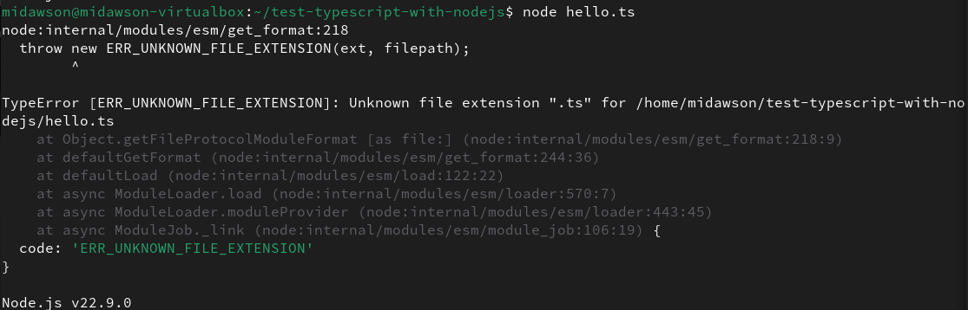
Experimental Limited Typescript Support (before)

Slide 19
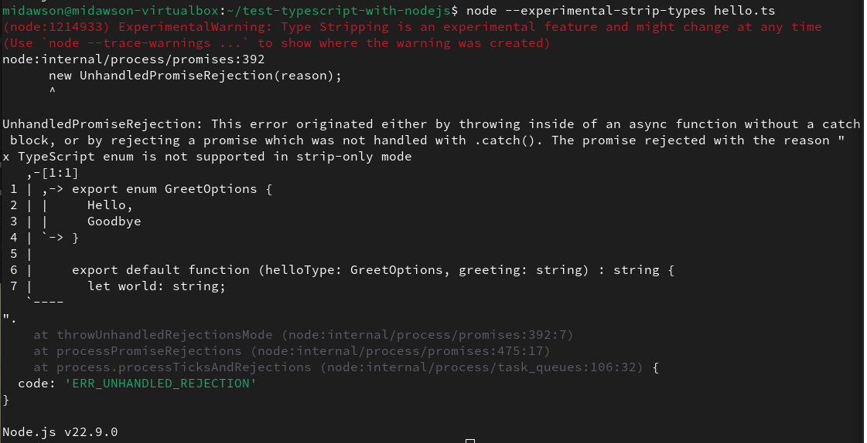
Experimental Limited Typescript Support

Slide 20
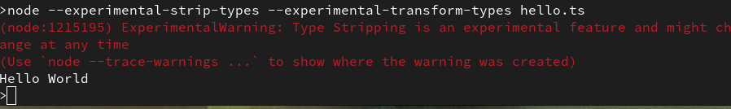
Experimental Limited Typescript Support

Slide 21
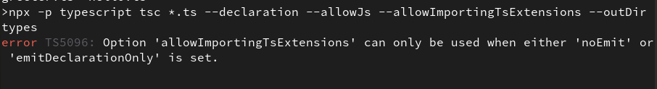

Experimental Limited Typescript Support
TSC has/had trouble with .ts extensions in imports
Node.js Typescript team -
Members from typescript,Node.js collaborated on issue
PR landed to handle https://github.com/microsoft/TypeScript/pull/59767
--rewriteRelativeImportExtensions

Slide 22
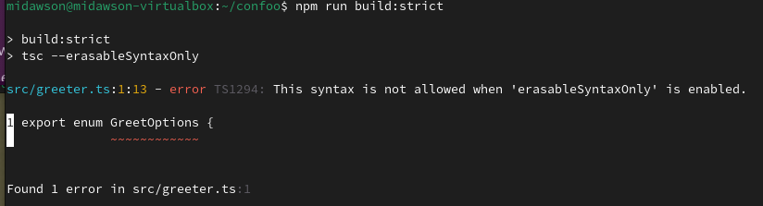
Experimental Limited Typescript Support
TypeScript 5.8 - Option to target only subset enabled by default
--erasableSyntaxOnly
https://devblogs.microsoft.com/typescript/announcing-typescript-5-8-beta/#the---erasablesyntaxonly-option

Slide 23
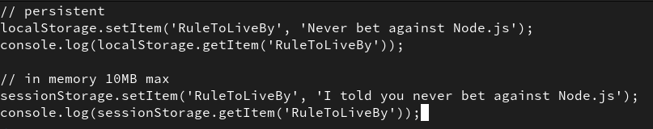
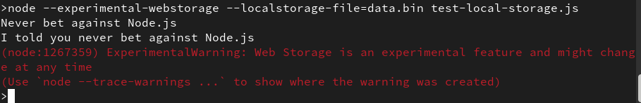
Experimental Web Storage API

Slide 24
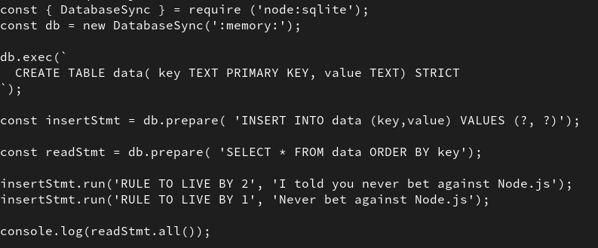
Experimental SQLite API

Slide 25
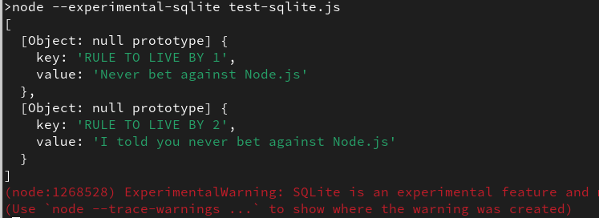
Experimental SQLite API

Slide 26
Continued progress on performance
Newer versions of V8
On-disk caching to improve startup
NODE_COMPILE_CACHE, NODE_DISABLE_COMPILE_CACHE
Buffer improvements
FS improvements

Slide 27
Node --run
Package.json
{
"name": "my-great-app",
"version": "0.0.1",
"scripts": {
"start": "node doit.js"
}
}
>node --run start
I ran

Slide 28
Node.js 24 specific highlights
V8 13.4
Atomics.pause - A new API to pause execution for a specified duration
WebAssembly Memory64 - Support for 64-bit memory in WebAssembly
Explicit resource management - The new 'using' and 'await using' declarations
Error.isError - A new static method to check if a value is an Error object
Npm 11.0.0
More efficient AsyncLocalStorage
URL Pattern global
Permission model improvements
Test runner enhancements
Undici 7.0.0

Slide 29
What’s new - Trends
node-addon-api overtakes Nan
Node.js/JavaScript support in AI libraries
TypeScript usage

Slide 30
Node-api/Node-addon-api
ABI stable
No code changes needed for new Node.js versions
Build once, run with later Node.js versions
Concepts and operations generally map to ideas specified in the ECMA262 Language Specification.
Cross runtime compatibility
Cross language support
Separation from Node.js itself

Slide 31
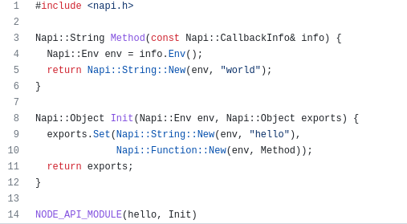
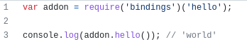
Building C/C++ addons - node-addon-api

Slide 32
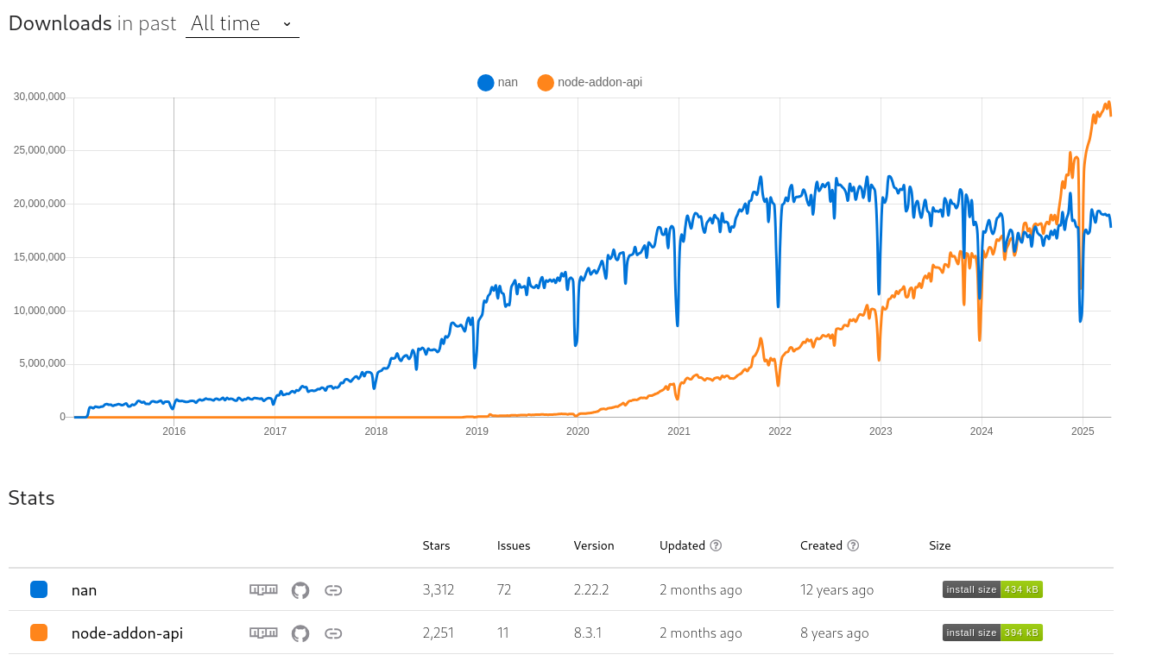
Building addons like its 2025
80% use case
~ 61% use
https://npmtrends.com/nan-vs-node-addon-api

Slide 33






Trends - AI developer libraries
JavaScript/Typescript 2nd language supported
Bee Agent

Slide 34
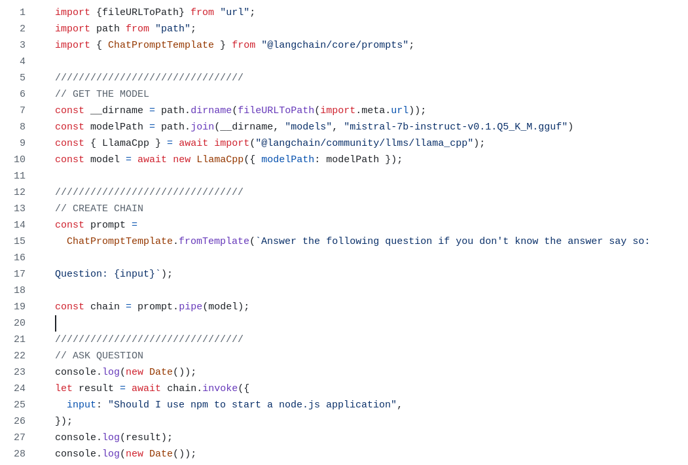
Trends - AI developer libraries
https://developers.redhat.com/blog/2024/11/20/essential-ai-tutorials-nodejs-developers

Slide 35
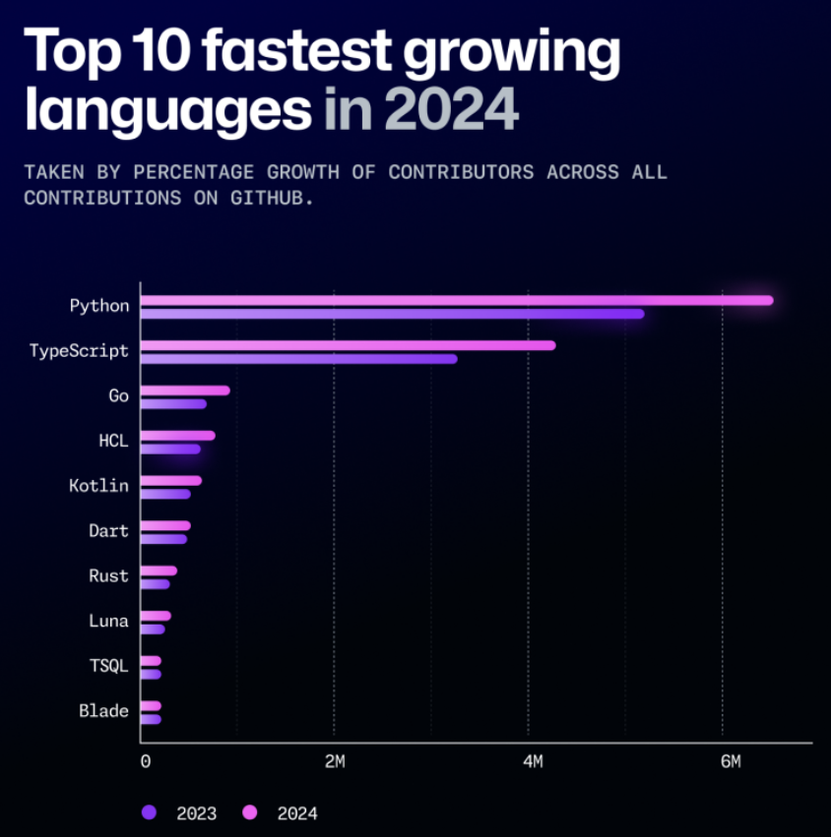
Trends - TypeScript usage

Slide 36
What’s Next ?
Who decides what’s next ?
Following what’s next
Next-10

Slide 37

Who Decides what’s next ?
X
TSC
Companies
An individual contributor
X
X

Slide 38
Who Decides what’s next ?
✔
All collaborators

Slide 39
Who Decides what’s next ?
All collaborators
Together
Real time
No pre-defined roadmap
Driven by
Doer’s
Reviewers/Approvers
Supported by Project’s documented Priorities

Slide 40

What’s Next

Slide 41
What’s Next
GitHub Notifications
Working Groups and Teams
Strategic Initiatives
Next-10
Releases
Node.js news feed https://nodejs.github.io/nodejs-news-feeder/feed.xml
https://nodejs.org/calendar
https://github.com/nodejs/node/blob/master/doc/guides/strategic-initiatives.md
https://github.com/nodejs/next-10
https://github.com/nodejs/release

Slide 42
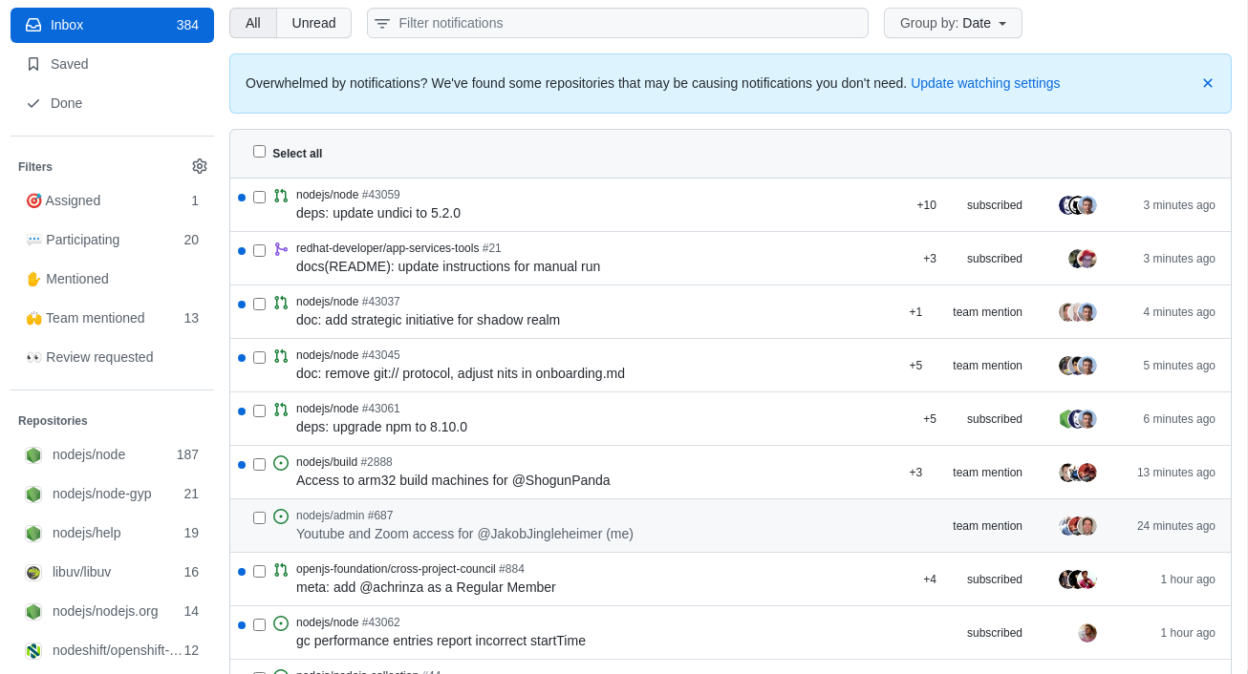
Following What’s Next - from the Ground up
GitHub Notifications
Working Groups and Teams
Strategic Initiatives
Next-10
Releases
https://nodejs.org/calendar
https://github.com/nodejs/node/blob/master/doc/guides/strategic-initiatives.md
https://github.com/nodejs/next-10
https://github.com/nodejs/release

Slide 43
What’s Next
GitHub Notifications
Working Groups and Teams
Strategic Initiatives
Next-10
Releases
Node.js news feed https://nodejs.github.io/nodejs-news-feeder/feed.xml
https://nodejs.org/calendar
https://github.com/nodejs/node/blob/master/doc/guides/strategic-initiatives.md
https://github.com/nodejs/next-10
https://github.com/nodejs/release

Slide 44
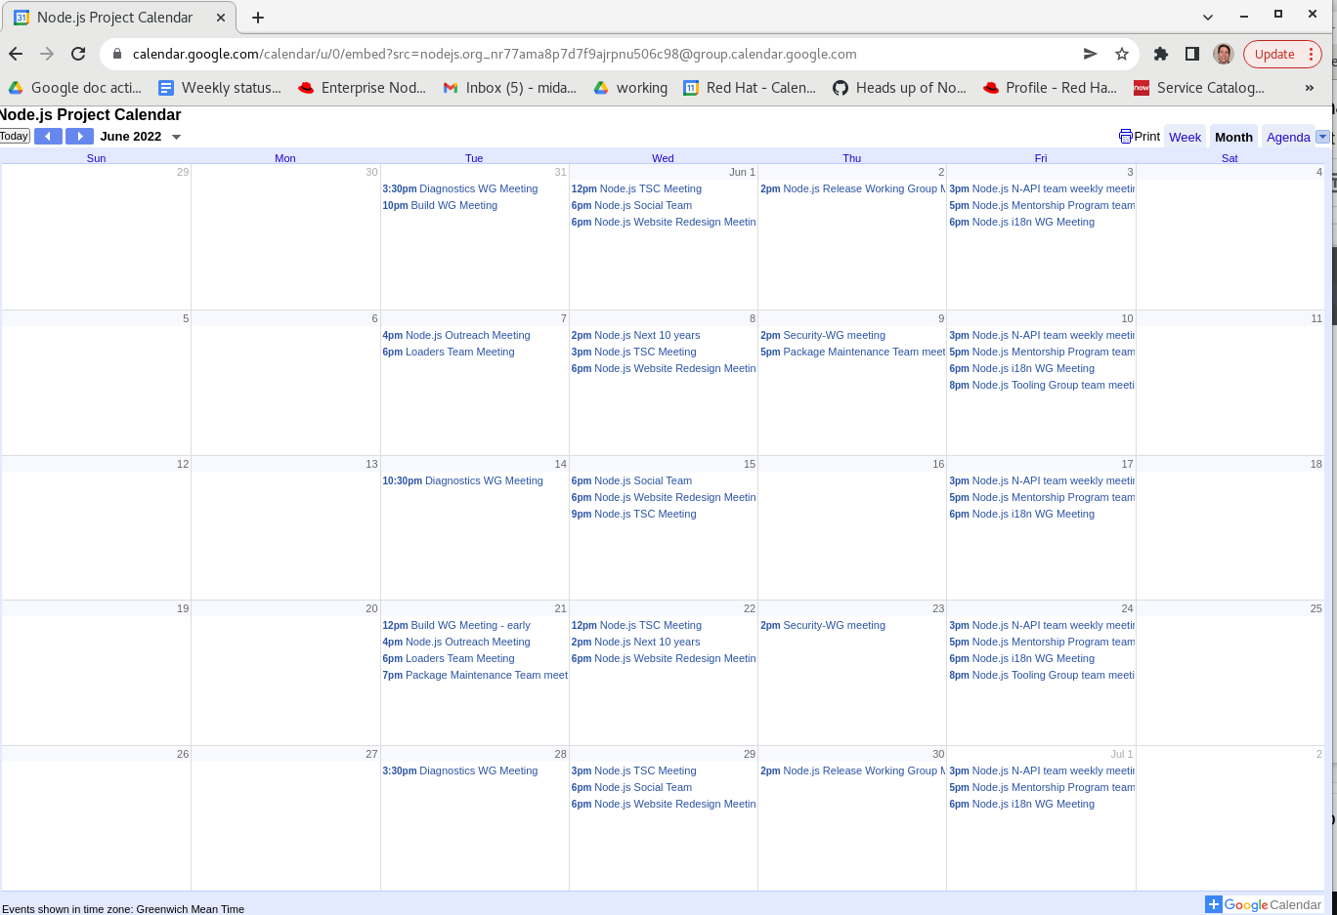
Following What’s Next - from the Ground up
GitHub Notifications
Working Groups and Teams
Strategic Initiatives
Next-10
Releases
https://nodejs.org/calendar
https://github.com/nodejs/node/blob/master/doc/guides/strategic-initiatives.md
https://github.com/nodejs/next-10
https://github.com/nodejs/release

Slide 45
What’s Next
GitHub Notifications
Working Groups and Teams
Strategic Initiatives
Next-10
Releases
Node.js news feed https://nodejs.github.io/nodejs-news-feeder/feed.xml
https://nodejs.org/calendar
https://github.com/nodejs/node/blob/master/doc/guides/strategic-initiatives.md
https://github.com/nodejs/next-10
https://github.com/nodejs/release

Slide 46
Next 10 - Foundation
Technical Values and Priorities
Constituencies
Constituencies Needs
https://github.com/nodejs/node/blob/main/doc/contributing/technical-values.md
https://github.com/nodejs/next-10/blob/main/CONSTITUENCIES.md
https://github.com/nodejs/next-10/blob/main/CONSTITUENCY-NEEDS.md

Slide 47
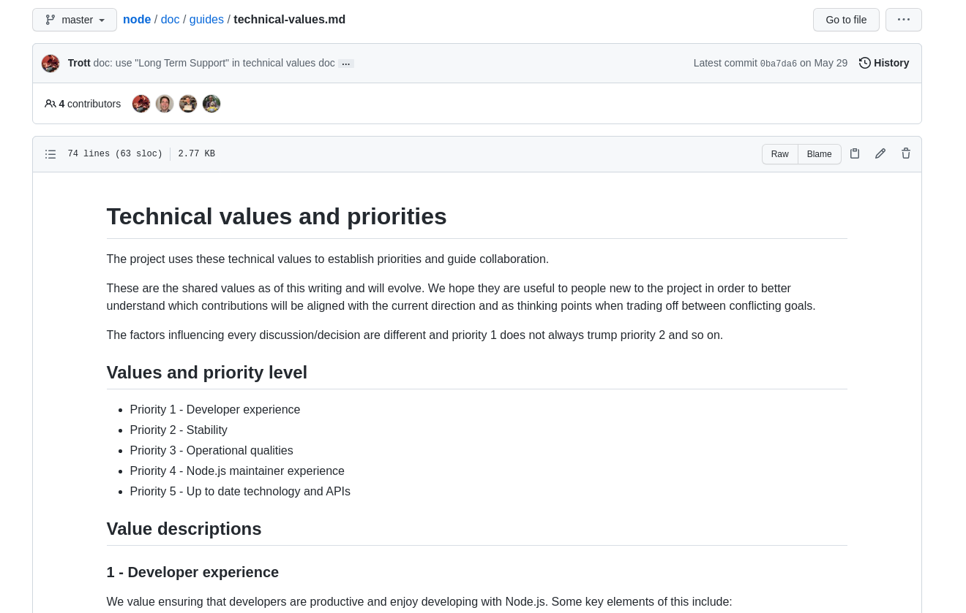
Next 10 - Foundation
Technical Values and Priorities
Constituencies
Constituencies Needs
https://github.com/nodejs/node/blob/master/doc/guides/technical-values.md
https://github.com/nodejs/next-10/blob/main/CONSTITUENCIES.md
https://github.com/nodejs/next-10/blob/main/CONSTITUENCY-NEEDS.md

Slide 48
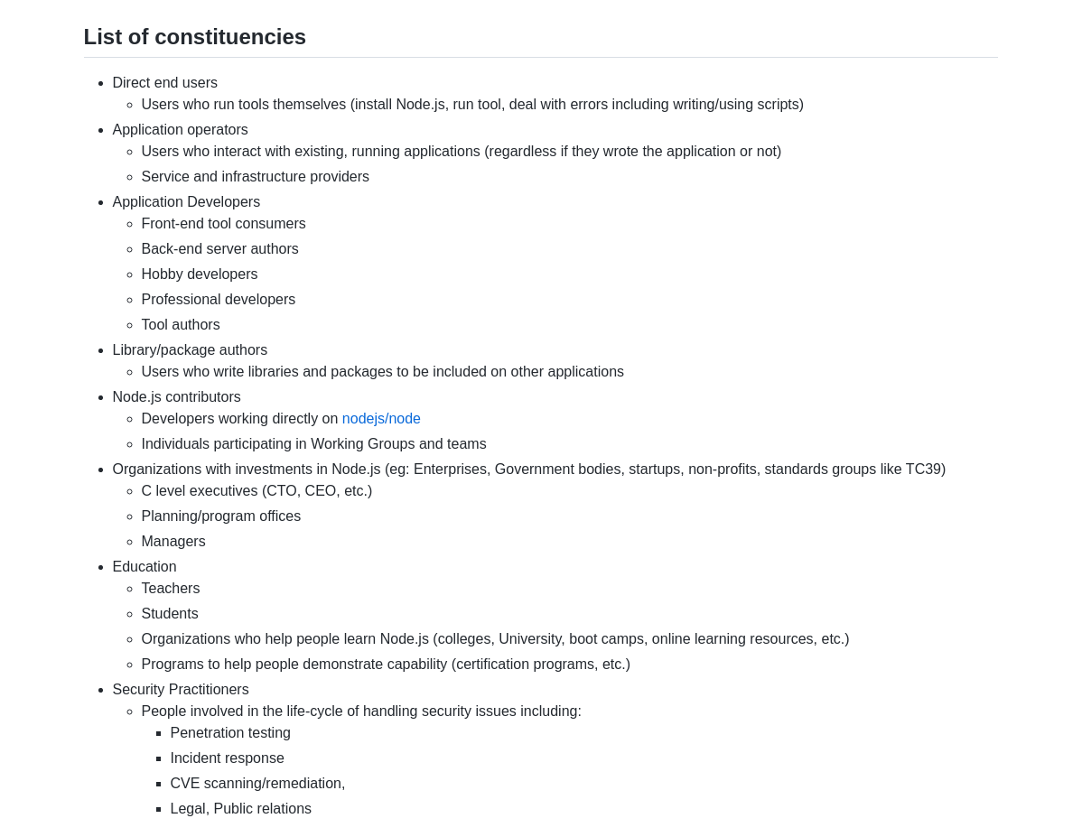
Next 10 - Foundation
Technical Values and Priorities
Constituencies
Constituencies Needs
https://github.com/nodejs/node/blob/master/doc/guides/technical-values.md
https://github.com/nodejs/next-10/blob/main/CONSTITUENCIES.md
https://github.com/nodejs/next-10/blob/main/CONSTITUENCY-NEEDS.md

Slide 49
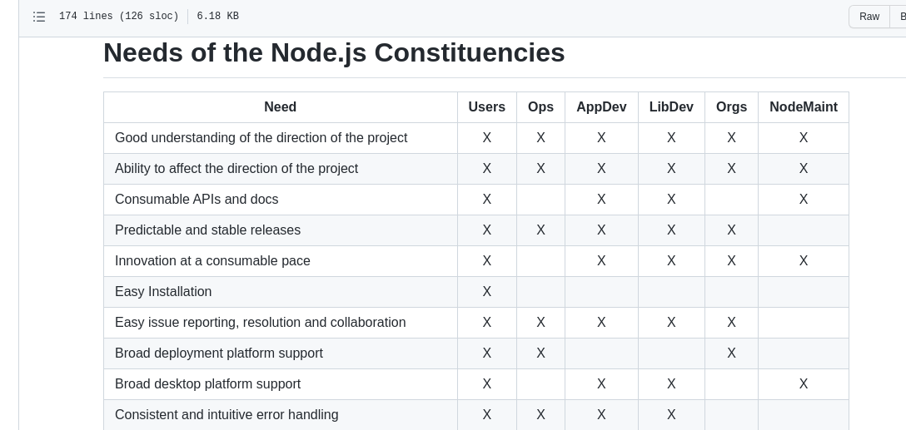
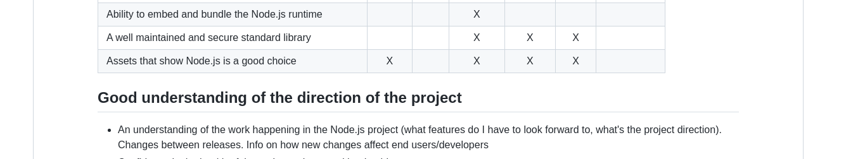
Next 10 - Foundation
Technical Values and Priorities
Constituencies
Constituencies Needs
https://github.com/nodejs/node/blob/master/doc/guides/technical-values.md
https://github.com/nodejs/next-10/blob/main/CONSTITUENCIES.md
https://github.com/nodejs/next-10/blob/main/CONSTITUENCY-NEEDS.md
.
.
.

Slide 50
Technical Priorities
https://github.com/nodejs/node/blob/master/doc/contributing/technical-priorities.md
Modern HTTP
Suitable types for end-users
Documentation
WebAssembly
ES Modules (ESM)
Support for features from the latest ECMAScript spec
Observability
Better multithreaded support
Single Executable Applications
Serverless
Small footprint
Developers-first DX
Package management

Slide 51
Next 10 team
Technical priorities well defined
Aligned based on survey results
Current focus areas less technical
Advocacy and promotion
Ambassador program
Corporate usage stories
News Feed - https://nodejs.github.io/nodejs-news-feeder/feed.xml
Funding
Collaborator Health
https://github.com/nodejs/node/blob/main/doc/contributing/advocacy-ambasador-program.md

Slide 52
What’s next
Continued work on
ESM
Typescript
Performance
QUIC
…

Slide 53

What’s Next?
What about other pain points ?
Docs Initiative - https://github.com/nodejs/next-10/issues/166
Monitoring/Diagnostics
diagnostics team
AsyncLocalStorage rewritten not to use Async Hooks
Key components moved into org
require-in-the middle ?
Most common pain points
ESM integration
TypeScript
Docs ✅
Monitoring/Diagnostics
Performance
✅

Slide 54
Thank You
Thank You
Questions?

Slide 55
Copyright and Trademarks
© Red Hat, IBM. All Rights Reserved
Red Hat, the Red Hat logos are trademarks or registered trademarks of Red Hat
IBM, the IBM logo, ibm.com are trademarks or registered trademarks of International Business Machines Corp.,
registered in many jurisdictions worldwide.
A current list of IBM trademarks is available on the Web at “Copyright and trademark information” at
www.ibm.com/legal/copytrade.shtml
Node.js is an official trademark of Joyent. IBM SDK for Node.js is not formally related to or endorsed by the official Joyent Node.js open source or commercial project.
Java, JavaScript and all Java-based trademarks and logos are trademarks or registered trademarks of Oracle and/or its affiliates.
npm is a trademark of npm, Inc.
Other trademarks or logos are owned by their respective owners.

